Slide 1
Project Report Update

Slide 2
Experimental Setup
Baseline model: Bayesian non-parametric algorithm and K-means clustering.
RL algorithms: Model-free
Policy optimization: policy optimization methods the agent learns directly the policy function that maps state to action. The policy is determined without using a value function.
Q-learning: Q-learning learns the action-value function Q(s, a).

Slide 3
Results Discussions
Advantages of RL
RL works by interacting with the environment.
The RL algorithm works like the human brain works when making some decisions.
There is no labeled dataset is present.
No previous training is provided to the learning agent.
RL helps to take decisions sequentially.
Advantages of Baseline
Relatively simple to implement.
Provides a standard for labelling datasets.

Slide 4
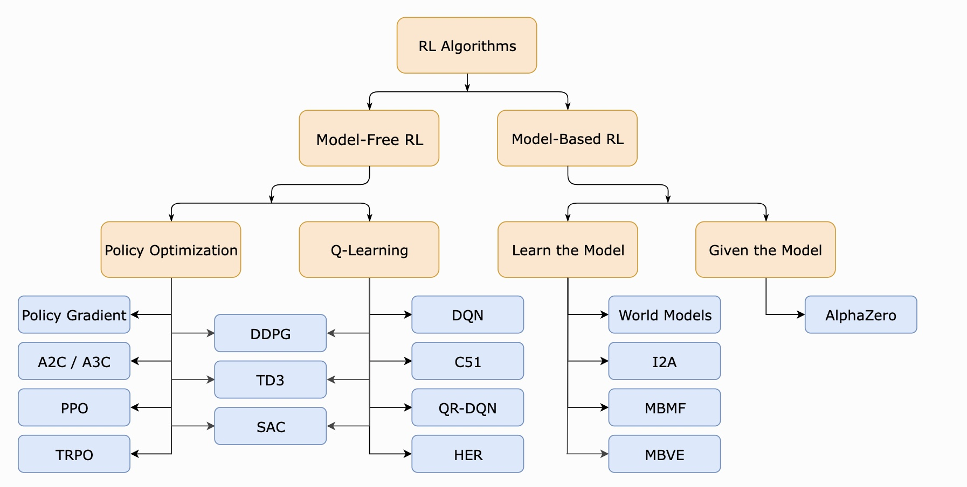
Project Update
A Taxonomy of RL Algorithms
[Link]

Slide 5
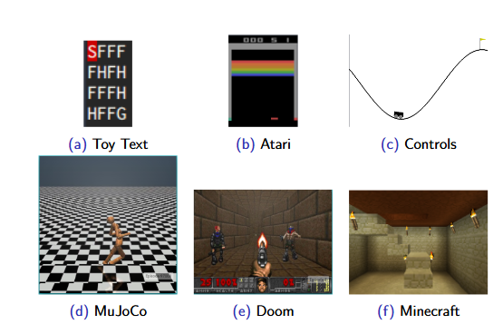
Open AI Gym
Gym is an open source Python library for developing and comparing reinforcement learning algorithms by providing a standard API to communicate between learning algorithms and environments, as well as a standard set of environments compliant with that API.
openai

Slide 6
How to use DRL to solve vehicle-server selection problem?
Reward: computational time (latency)
DRL Agents
Environment
Action: select, update, or maintain
Image size
Single agent: A2C, DDPG, PPO
Server location
Ensemble agents:
A2C+DDPG+PPO
Detected Objects
Vehicle location
State: observations
We present the state, action and reward design for our DRL algorithm

Slide 7
System Configuration
Python 3.6 environment with TensorFlow 1.13
Core i7 CPU computer
3.8 GHz and 32 GB RAM
Replay memory size to 128 and the mini­ batch size to 64.
The discount factor = 0.9
Epsilon ­greedy = 0.1
learning rate = 0.01
ReLU for the hidden layers and sigmoid output layer.
To optimize the loss function, we use the SGD optimizer.
we execute all the simulations over 2000 episodes.

Slide 8
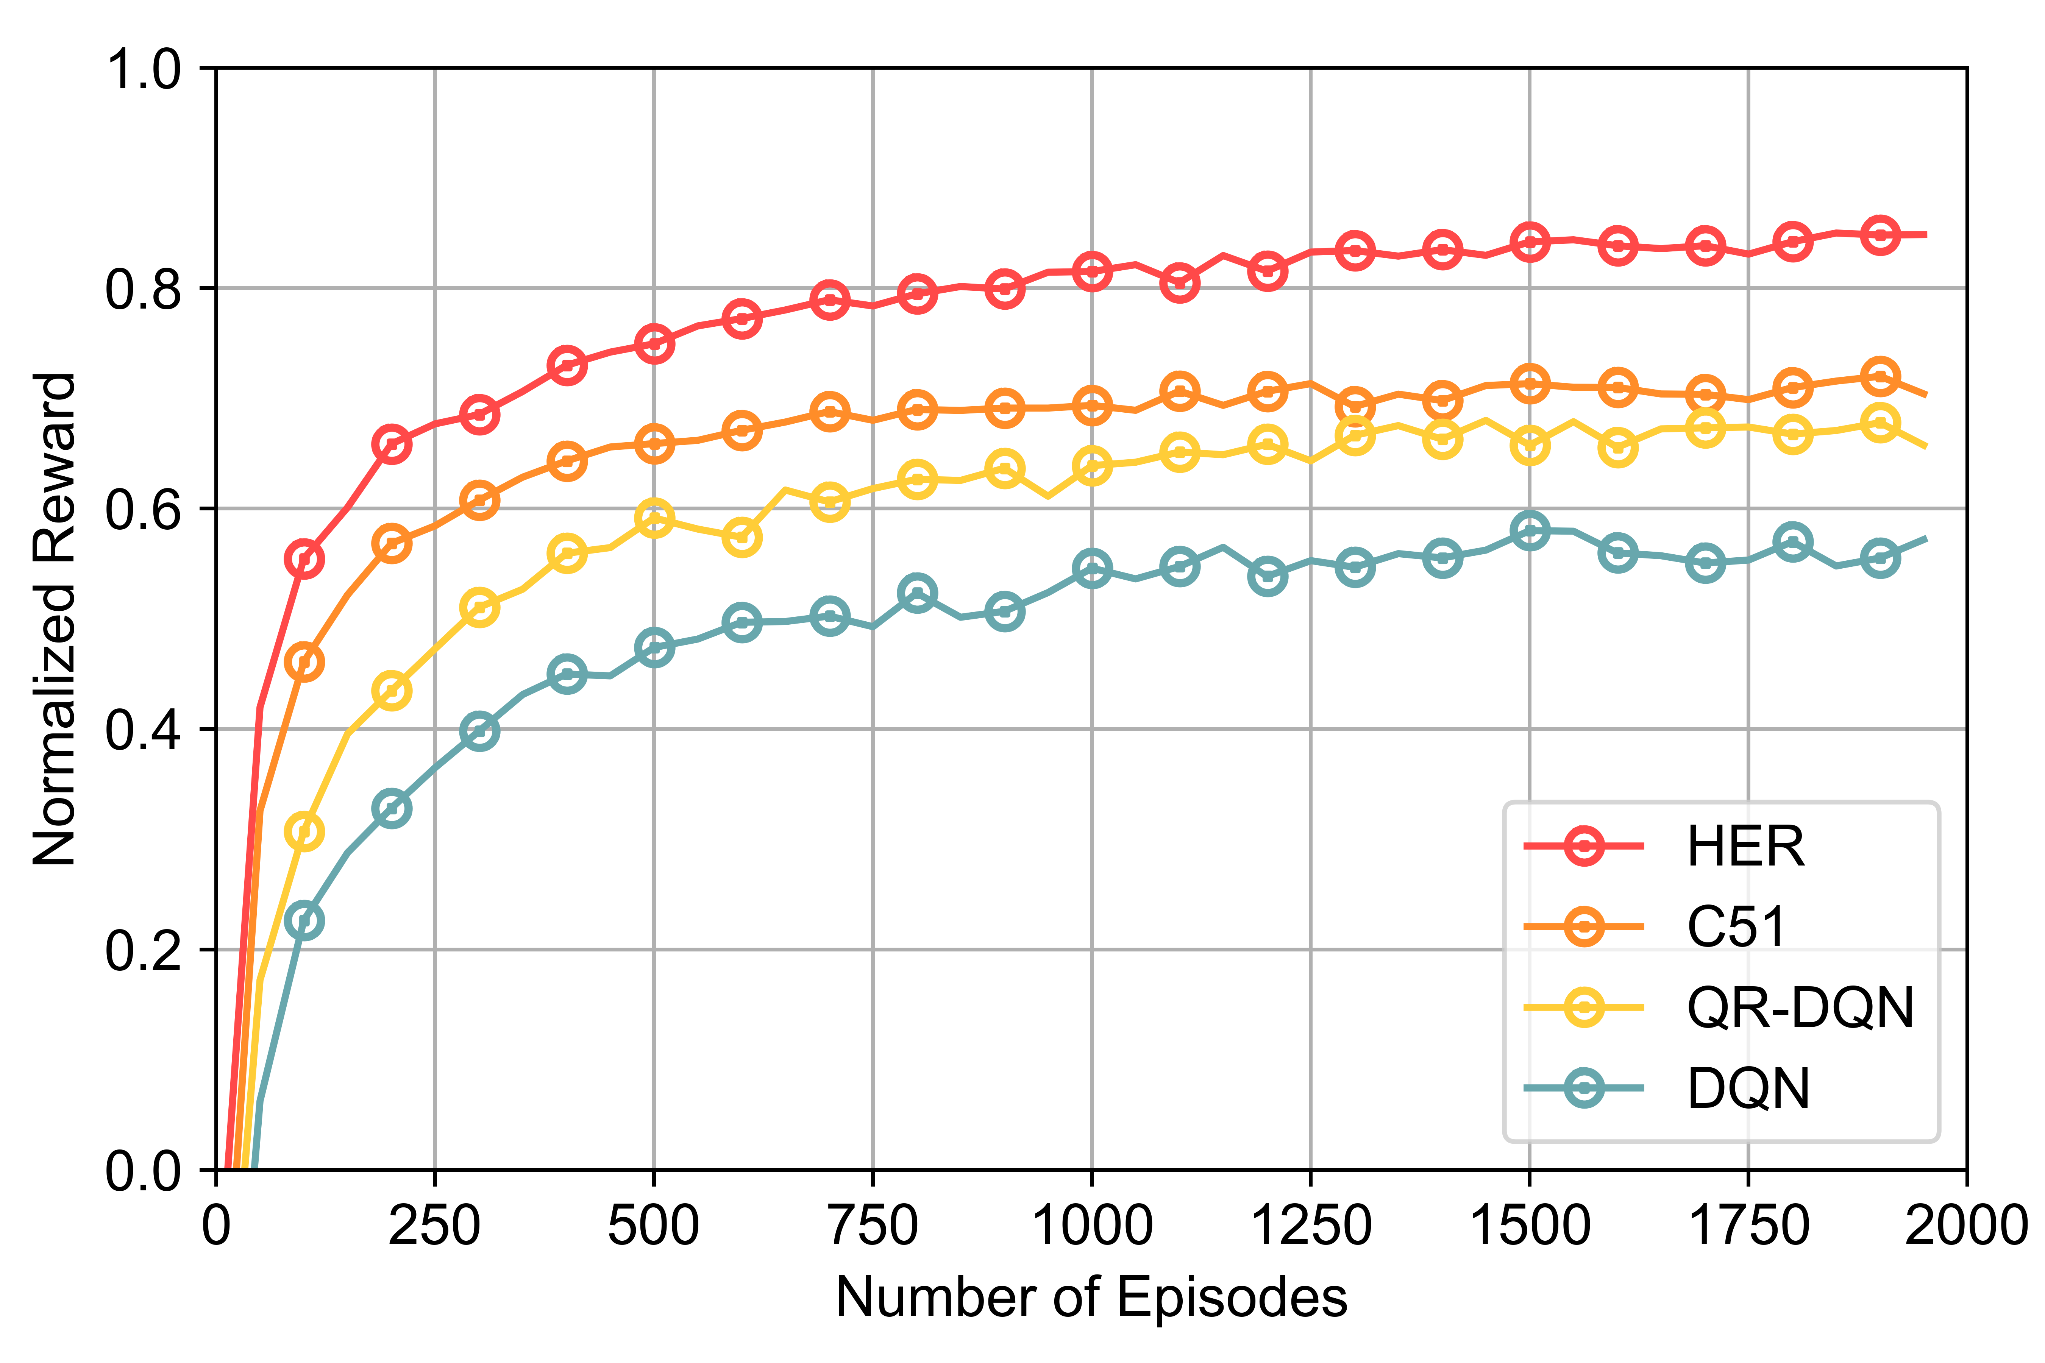
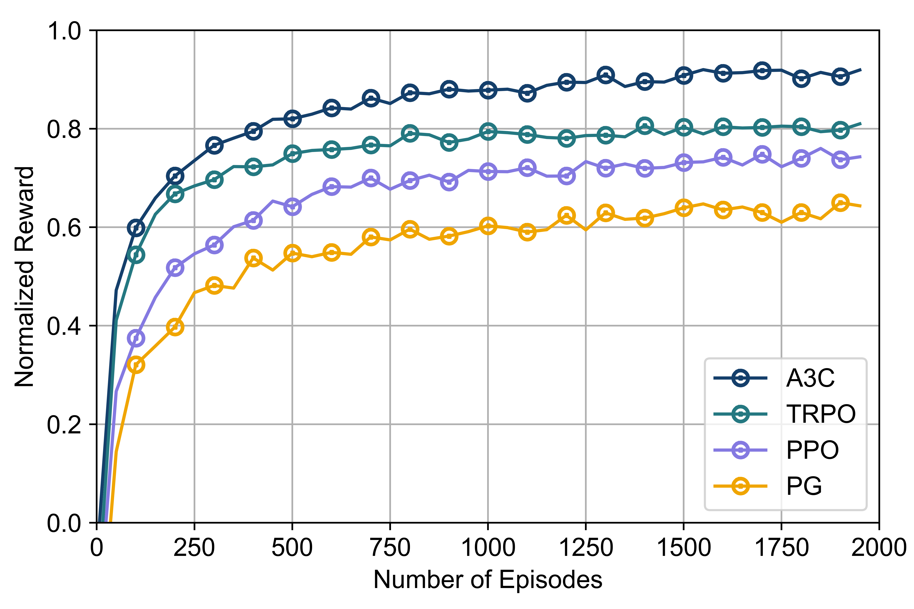
Results Discussions
Convergence analysis for Policy Optimization and Q-learning algorithms
(a) Q-learning: HER, C51, QR-DQN, DQN
(b) Policy Optimization: A3C, TRPO, PPO, PG

Slide 9
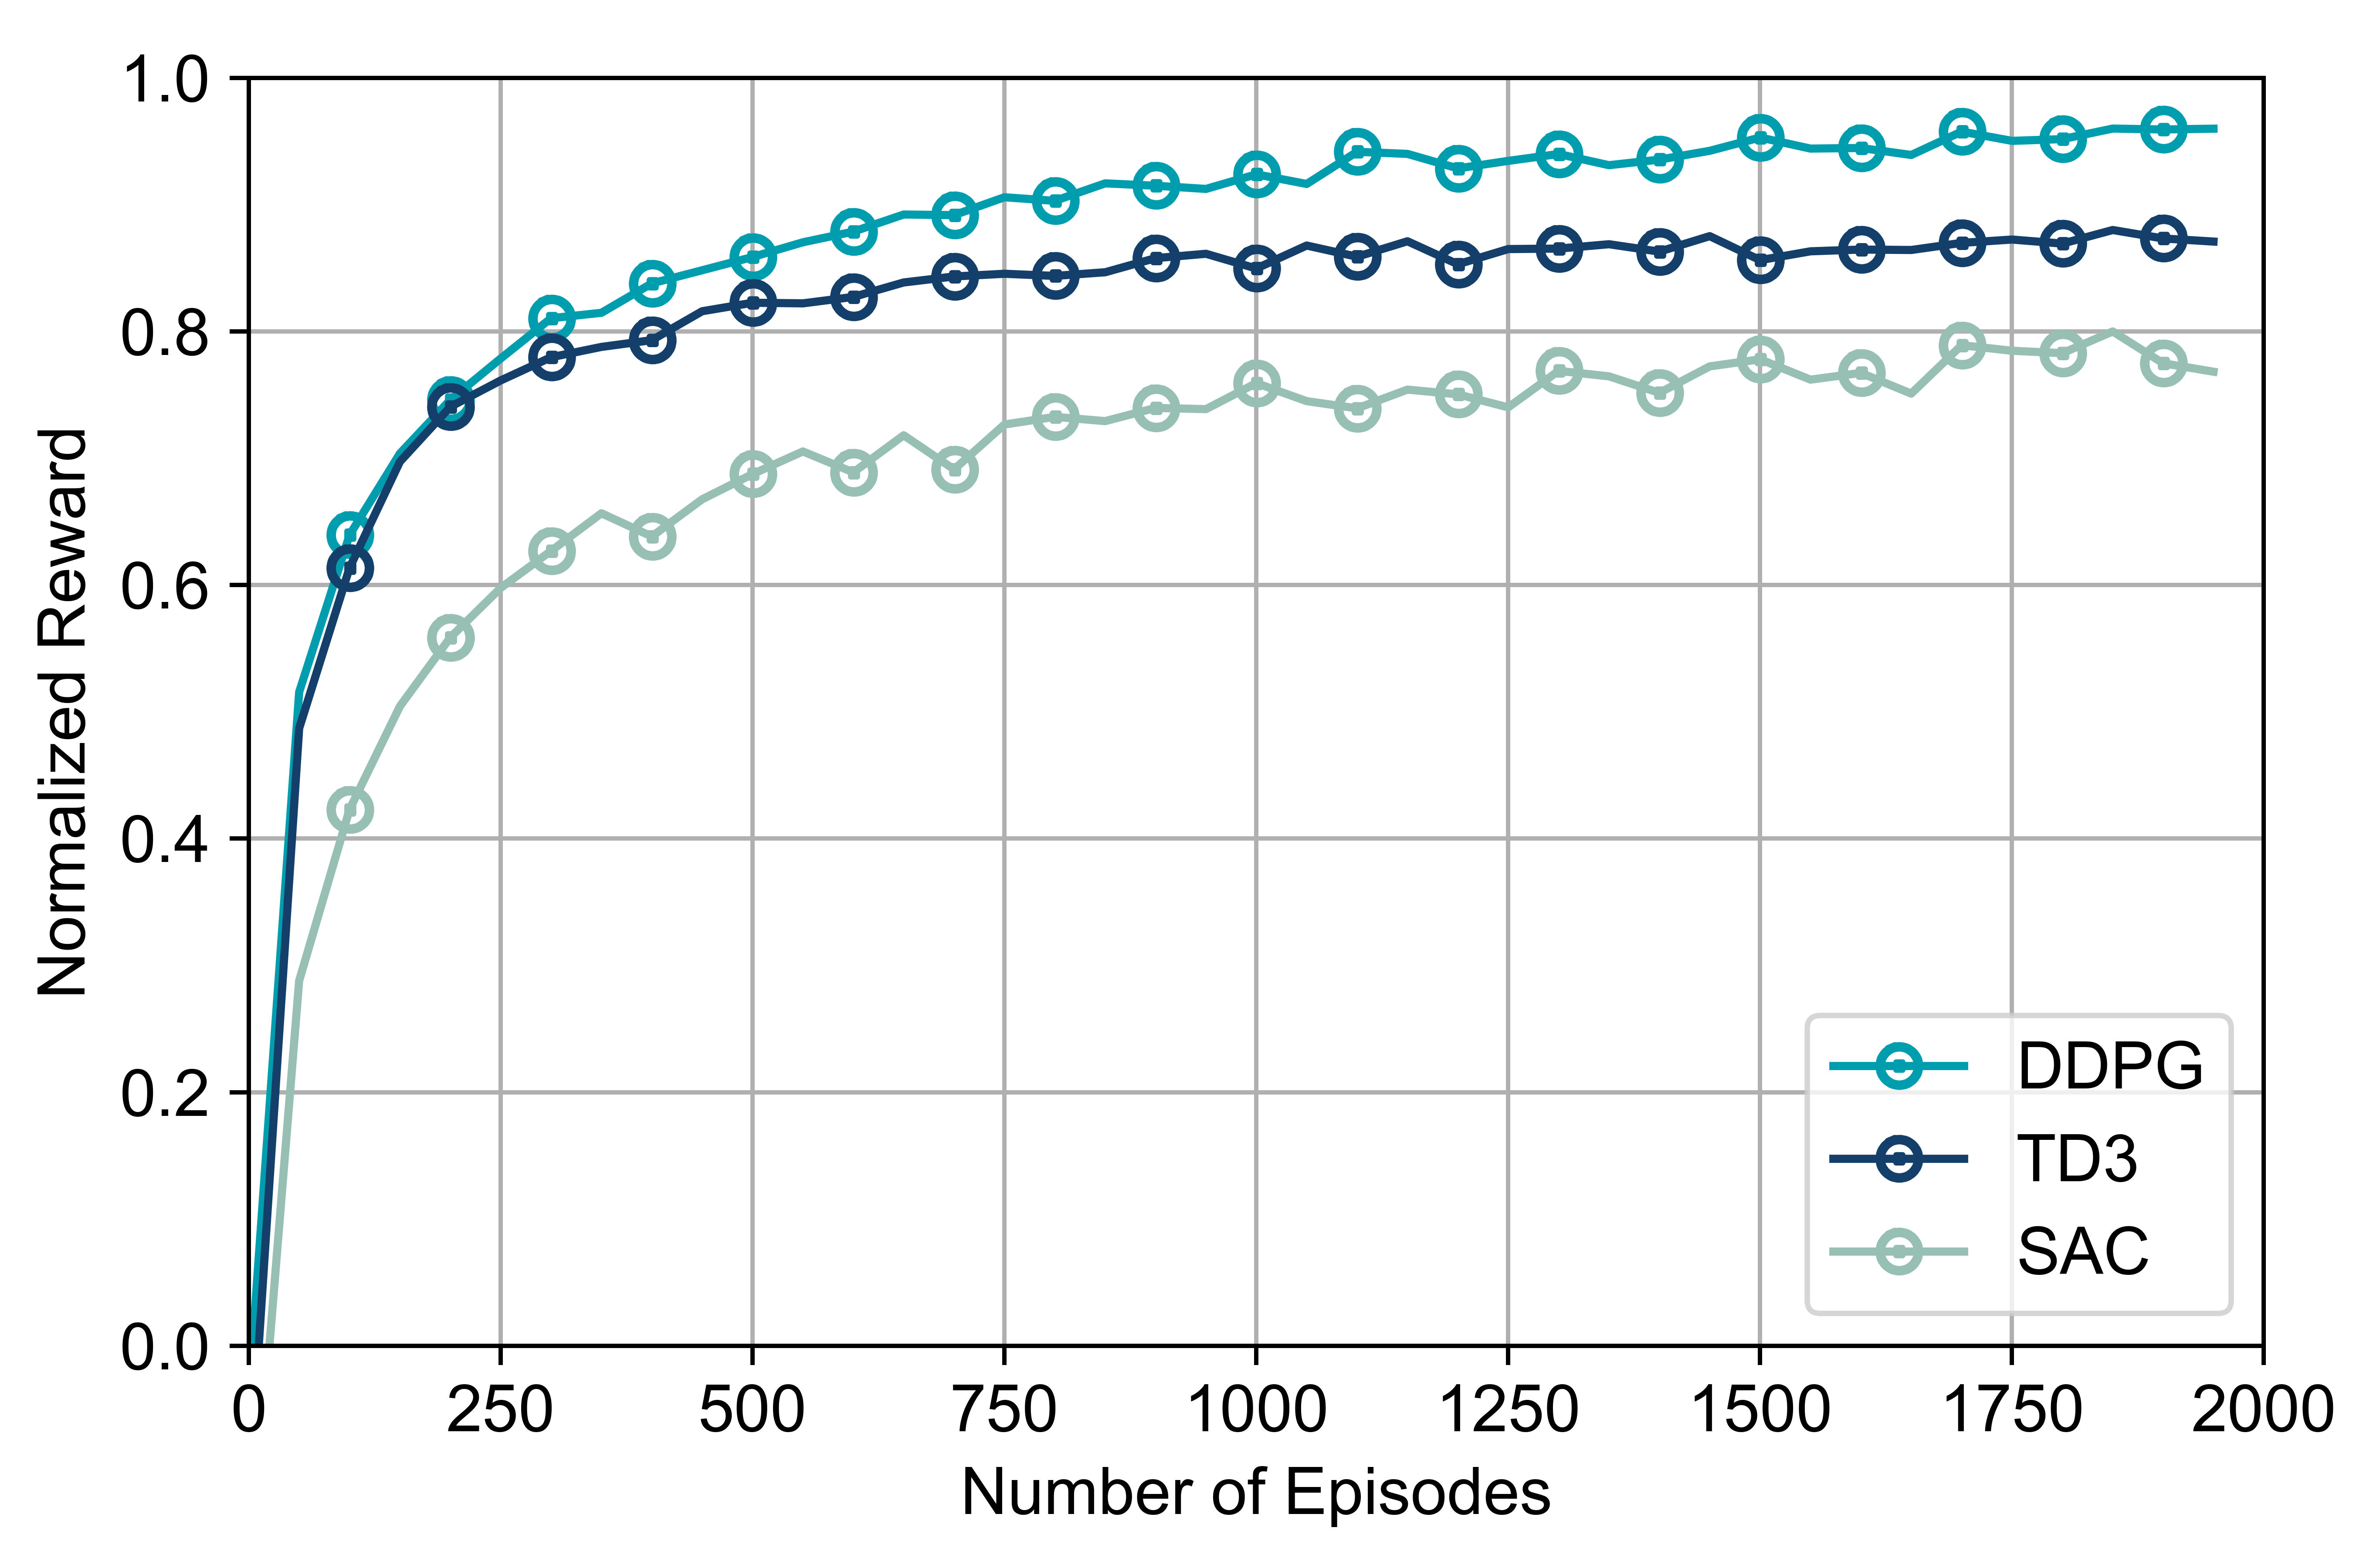
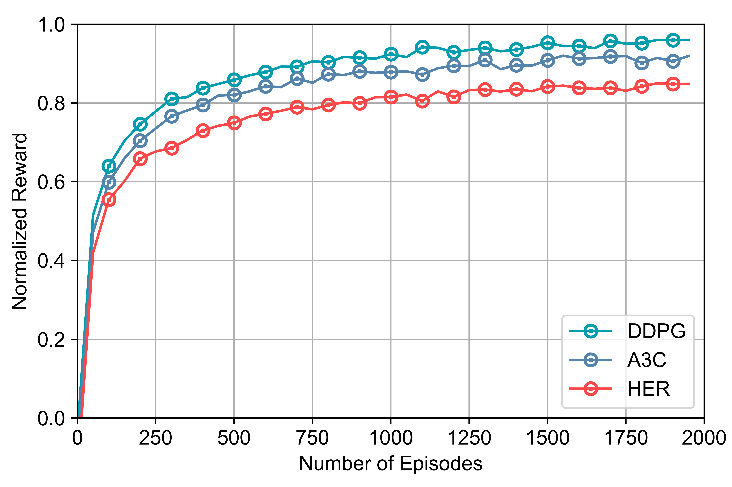
Results Discussions
Convergence analysis for hybrid RL algorithms and top selection for each group.
(a) Hybrid algorithms: DDPG, TD3, SAC
(b) Top algorithm selection: DDPG, A3C, HER

Slide 10
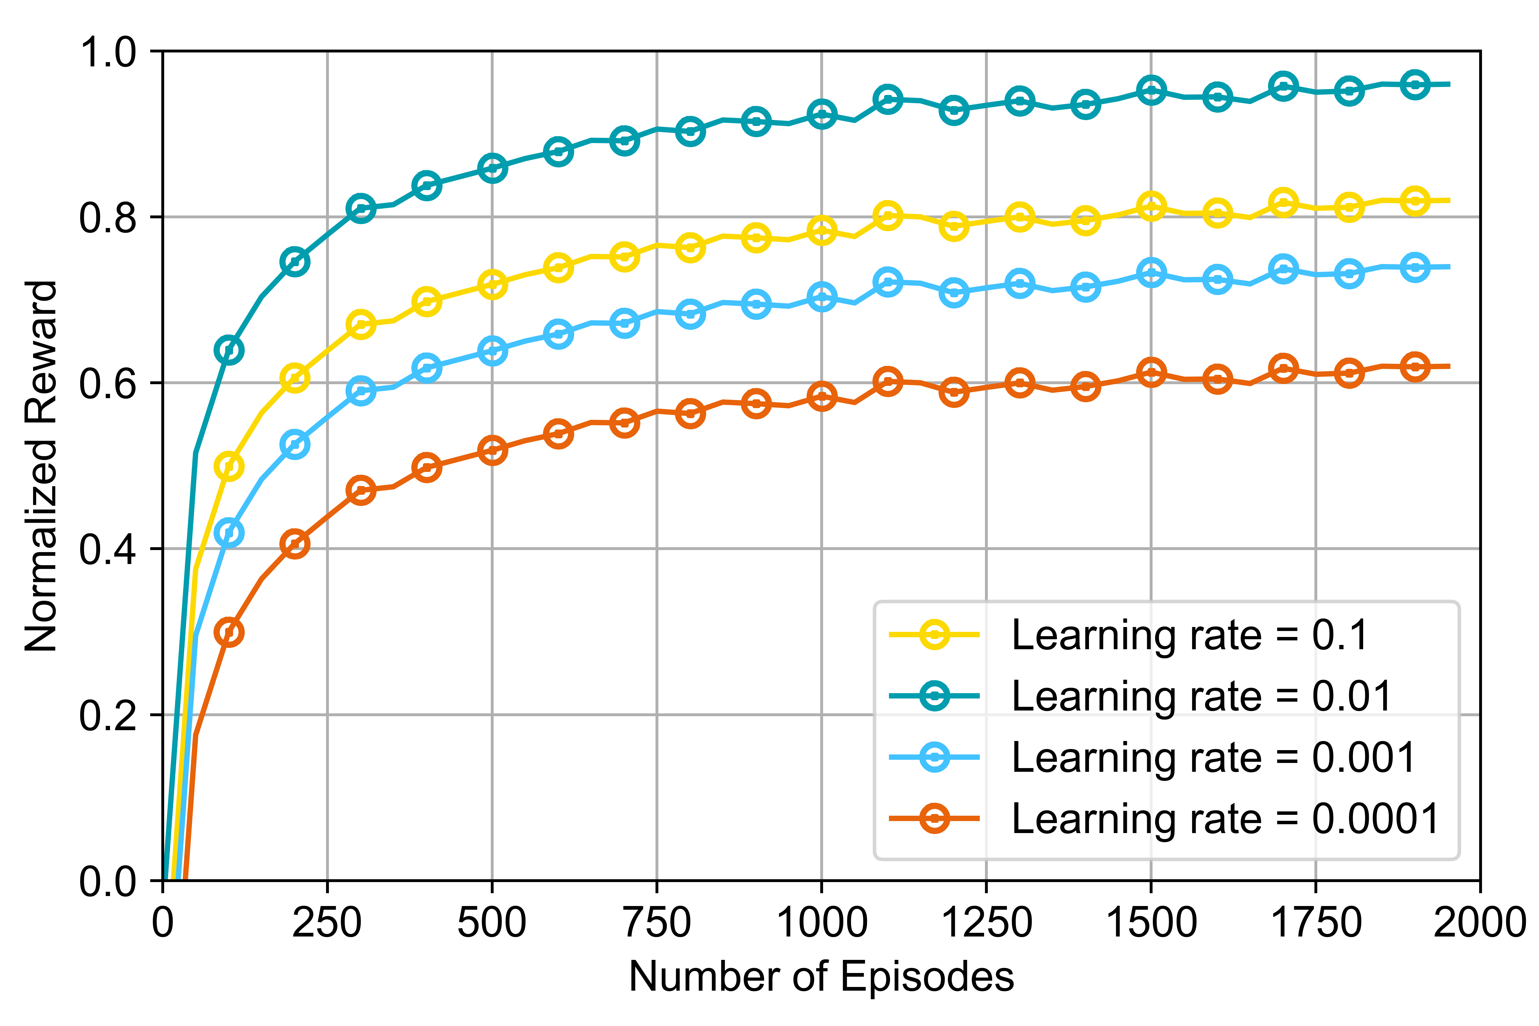
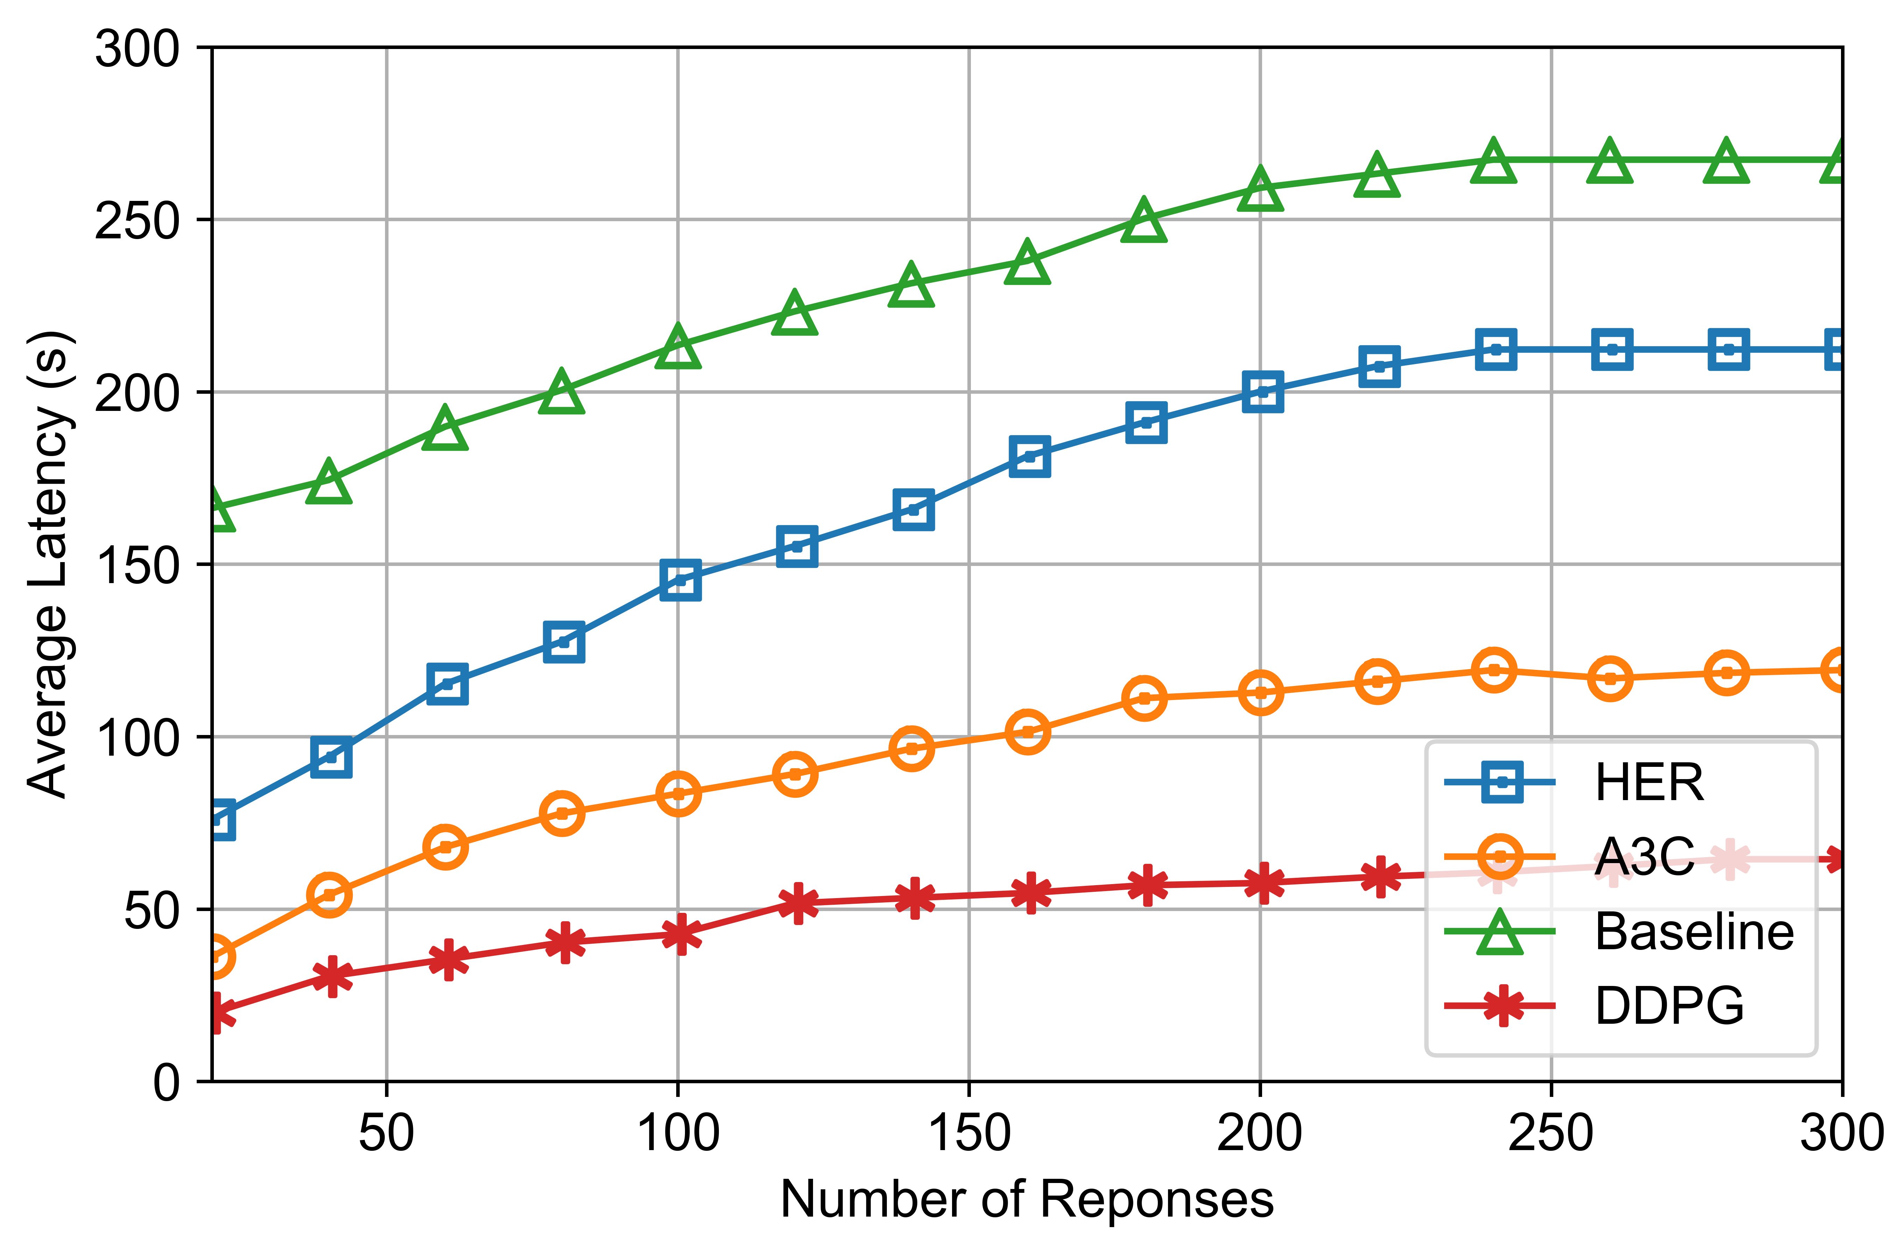
Results Discussions
Learning rate vs Average Latency
(a) Various learning rates of DDPG: 0.1, 0.01, 0.001, 0.0001
(b) Average latency: HER, A3C, Baseline, DDPG

Slide 11
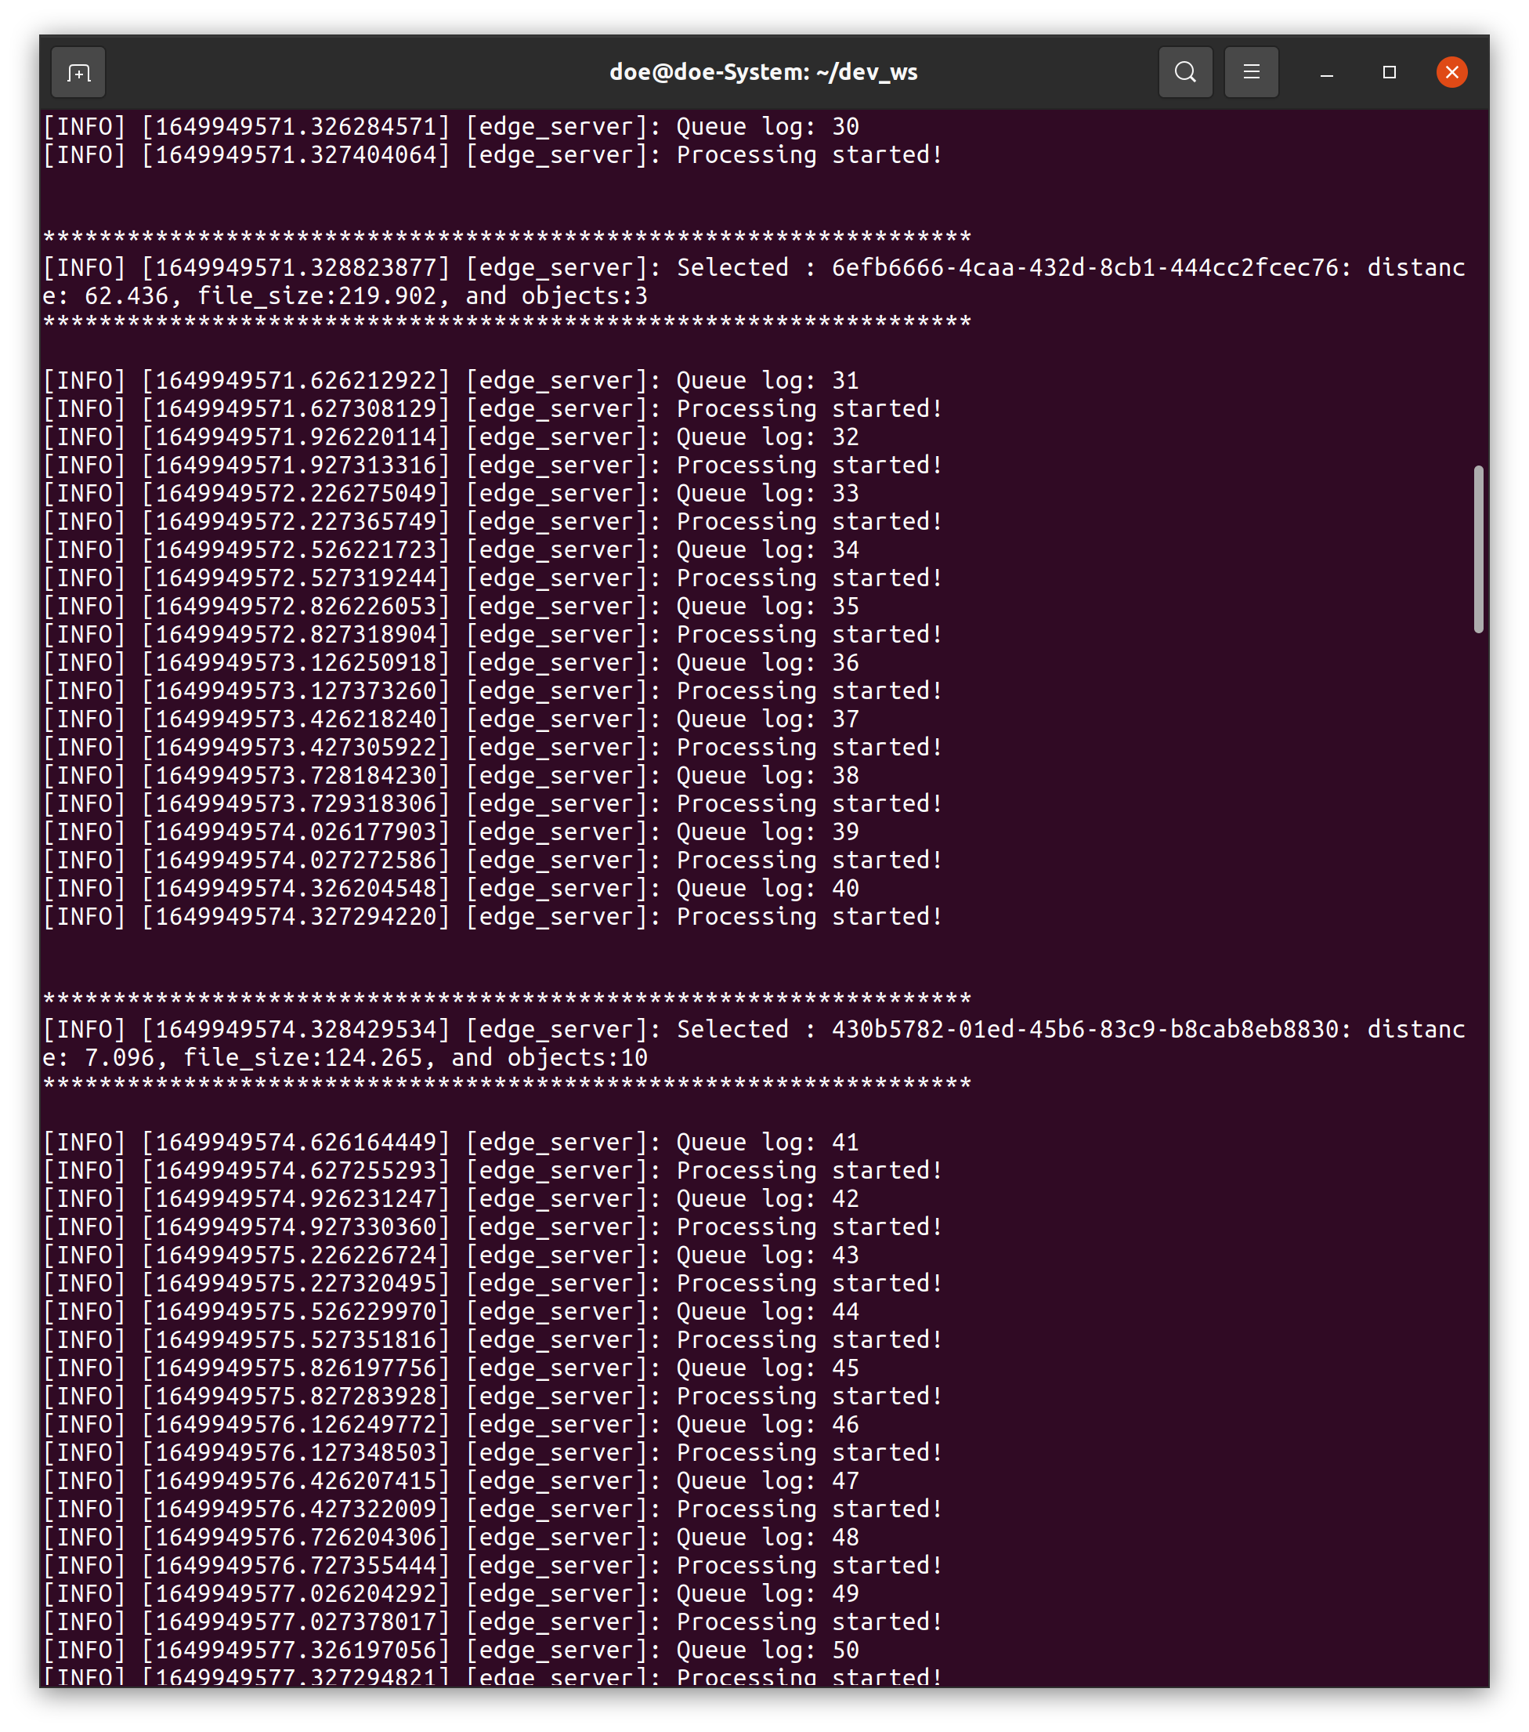
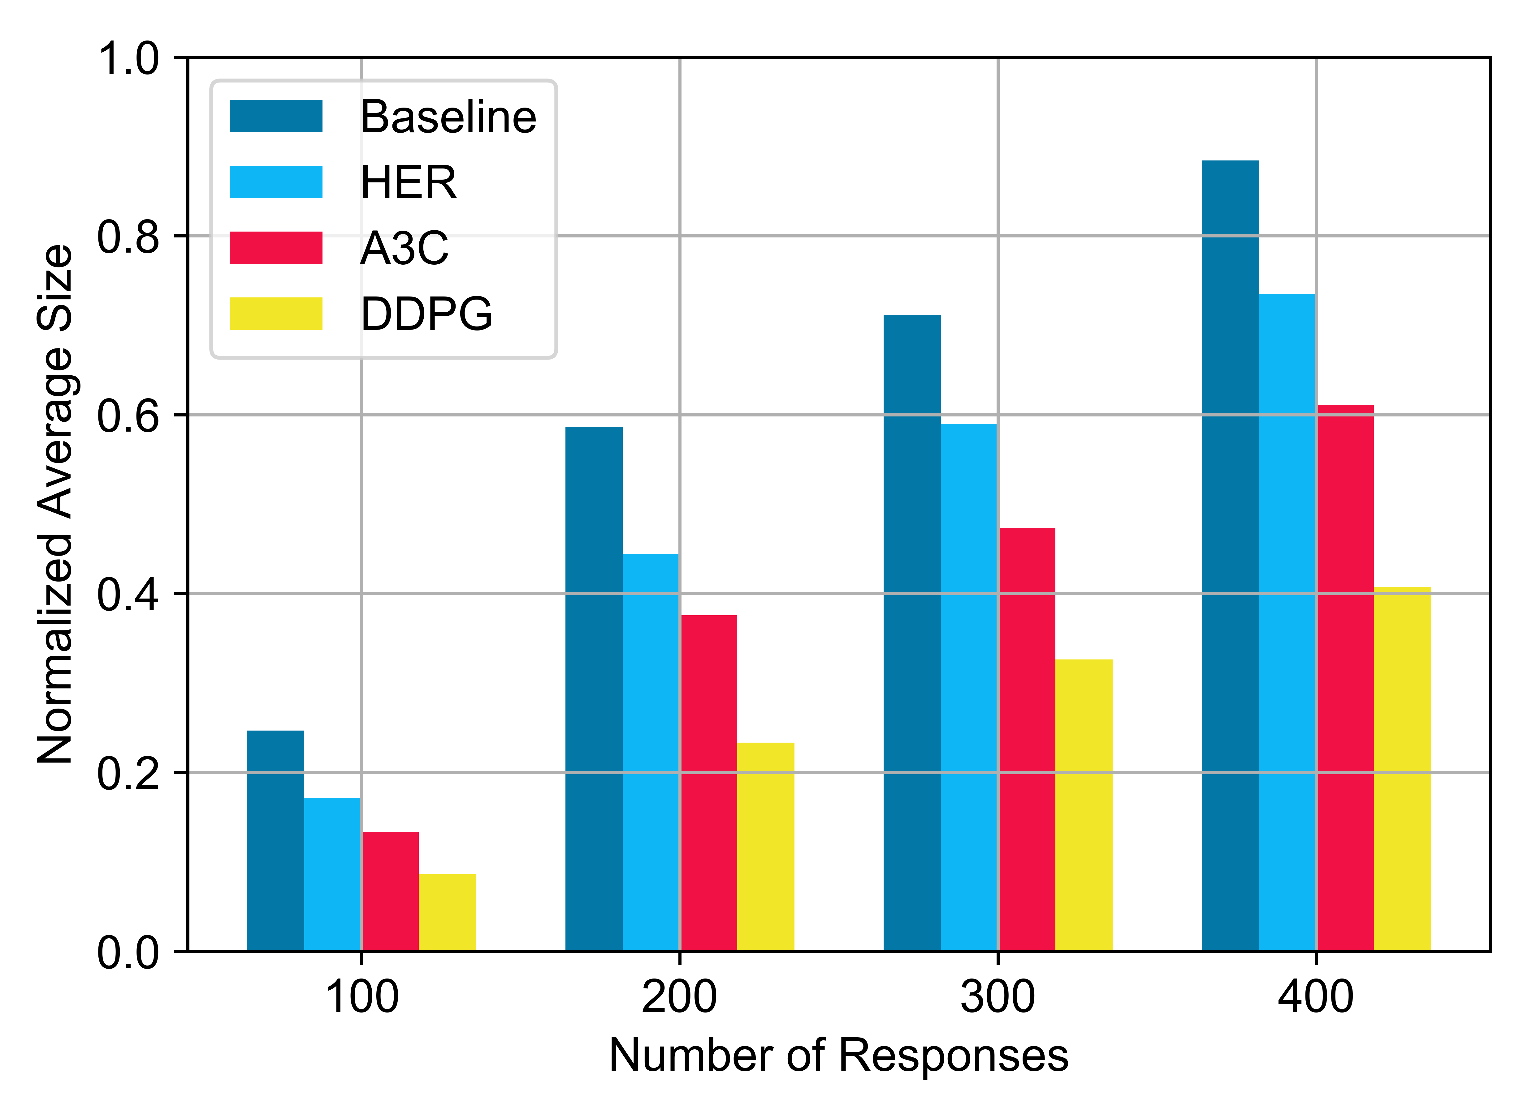
Results Discussions
Average Size and Implementation
(a) Normalized Average size

Slide 12
Final Remarks
Advantages of proposed scheme:
Achieves an improved latency
Efficient storage size optimization
Efficient bandwidth utilization
Enhanced real-time vehicle selection
Conclusion:
We implemented an image optimization algorithm to reduce the data size for data transfers.
We introduced a baseline model comprising a non-parametric Bayesian and K-means clustering for vehicle selection process.
We deployed a variety of DRL algorithms in the vehicle selection process to provide a real-time decision making progress.

Slide 13
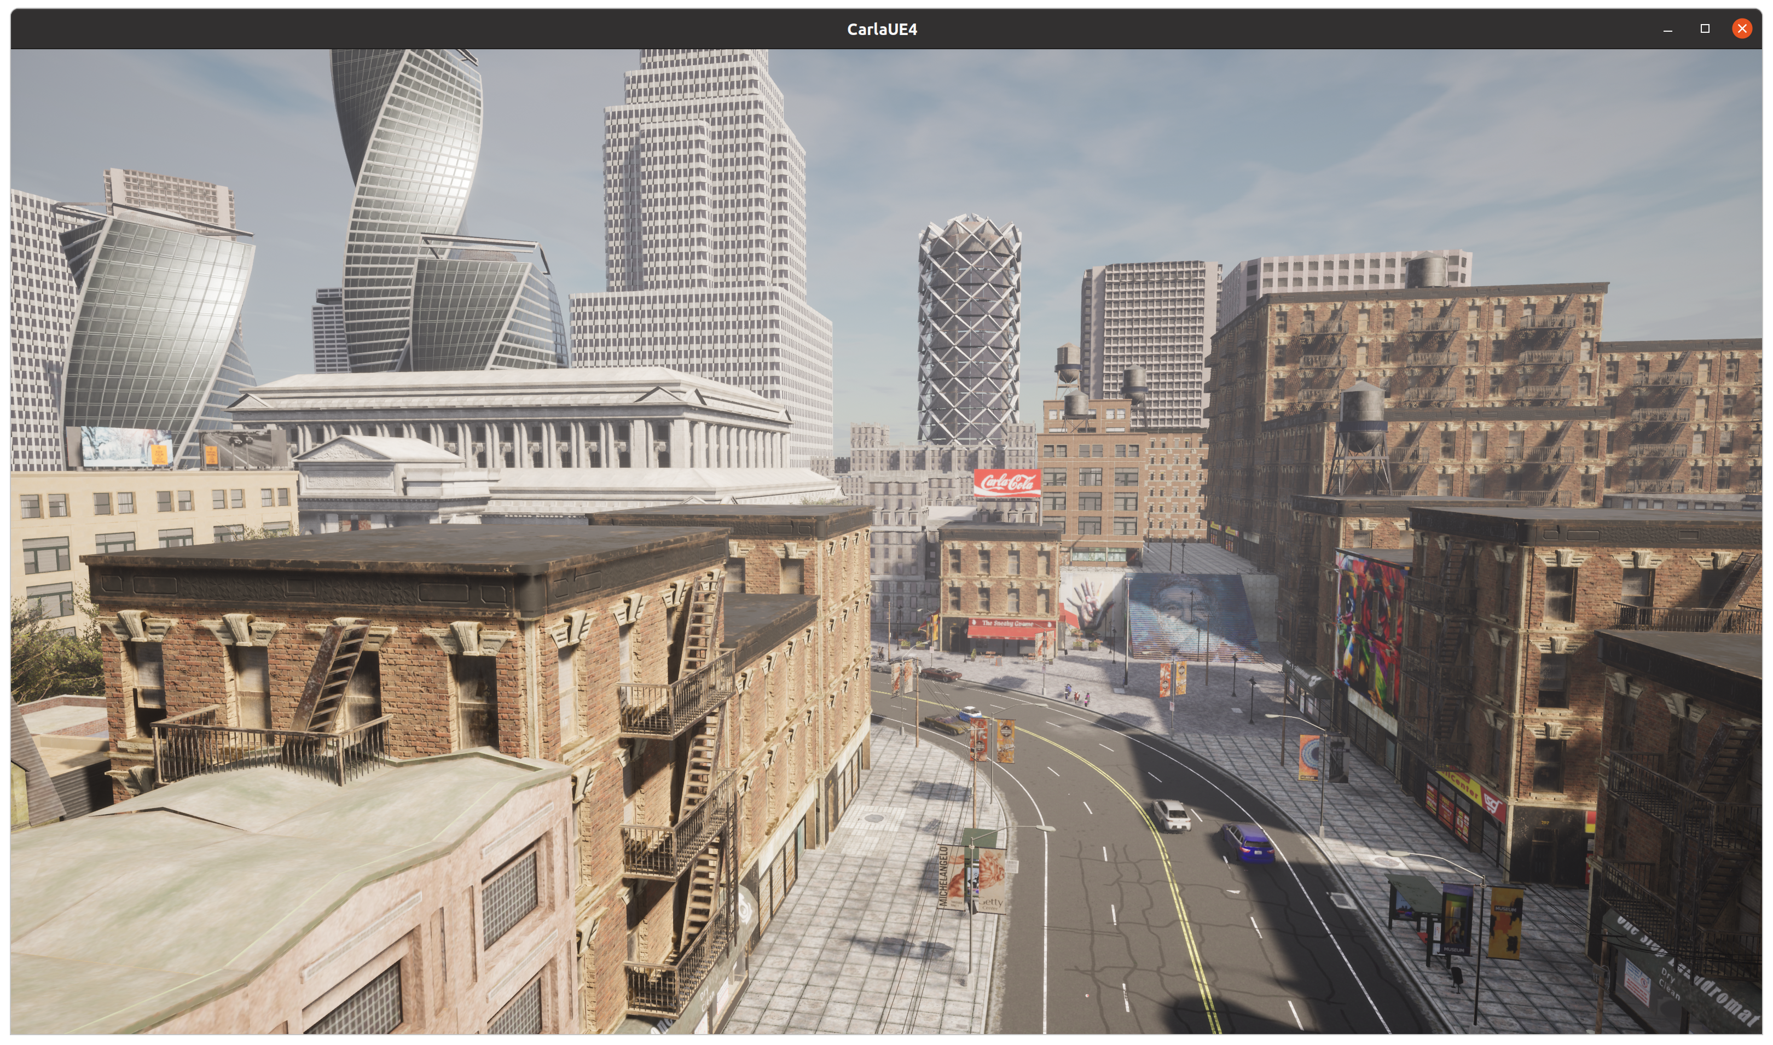
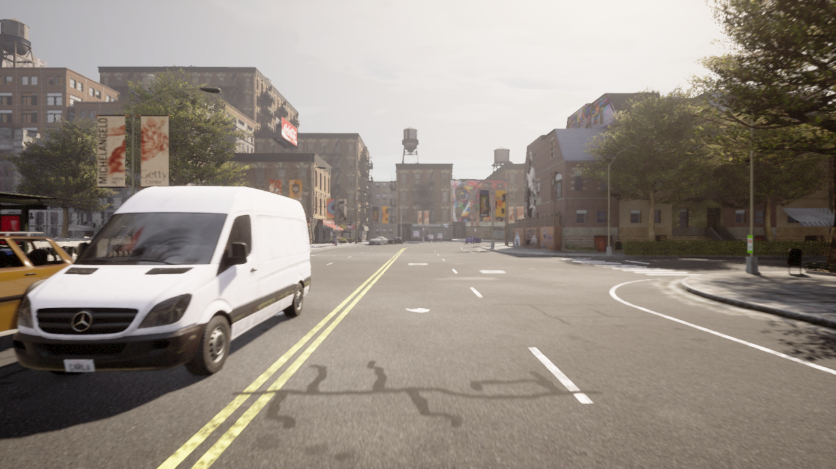
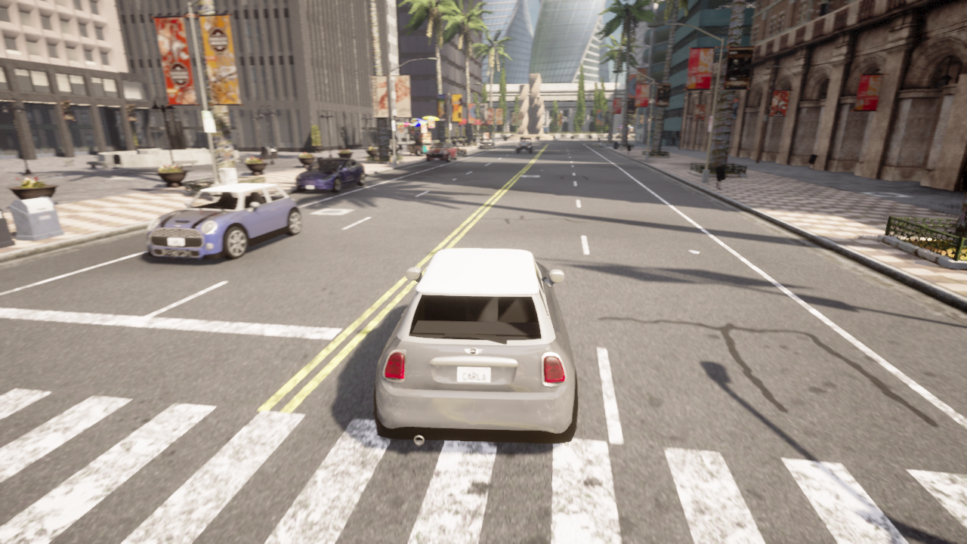
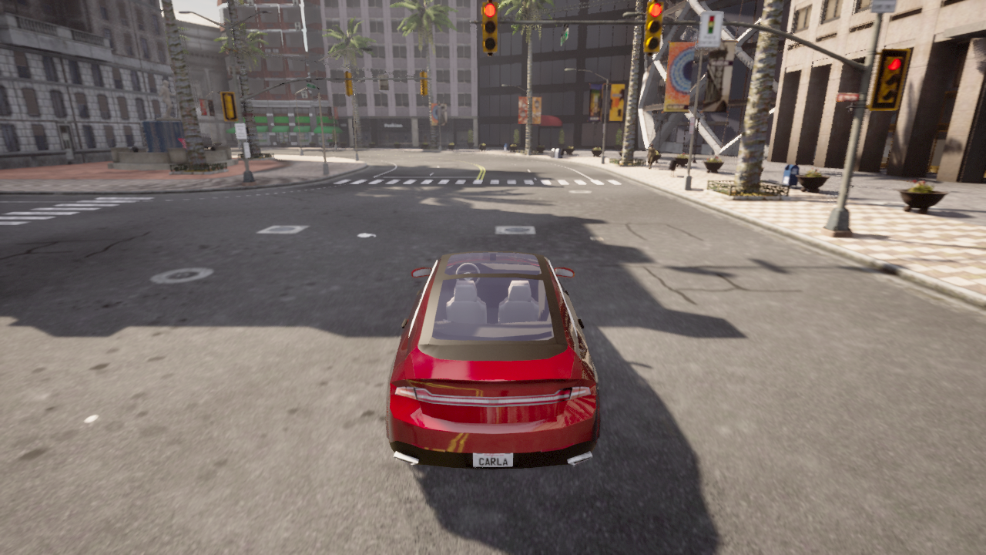
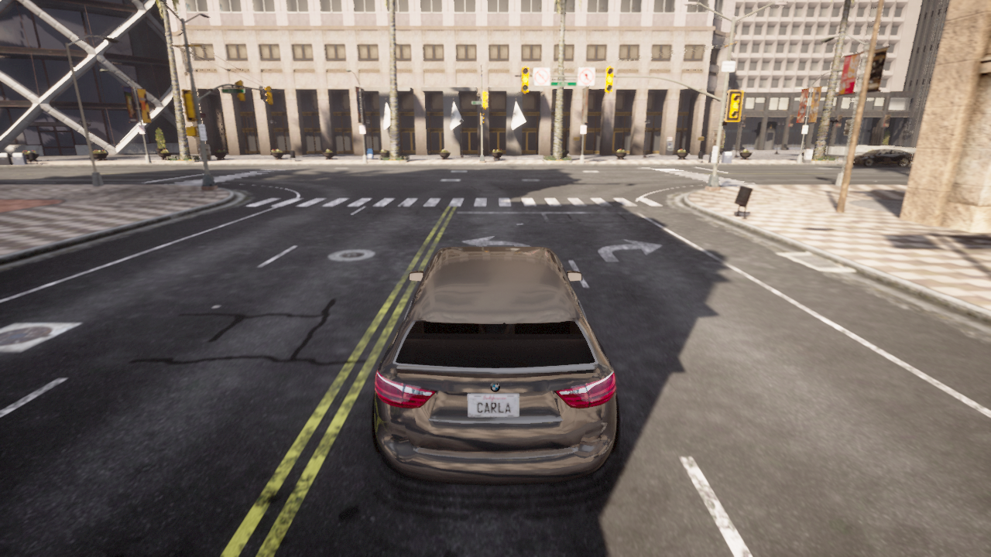
Experiment overview
Carla Environment
Vehicle data 1
Vehicle data 2
Vehicle data 3
First stage: Data collection

Slide 14
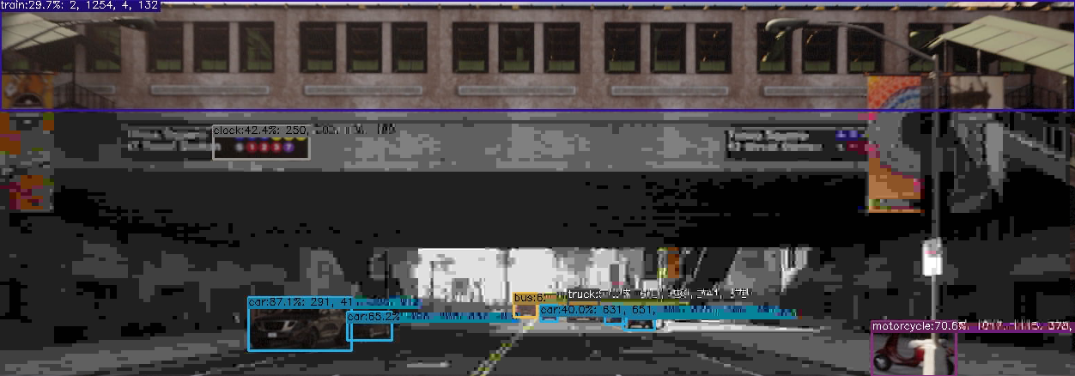
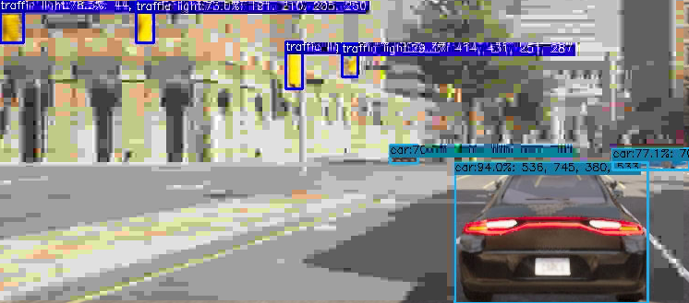
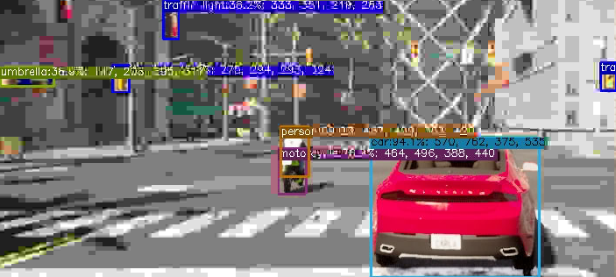
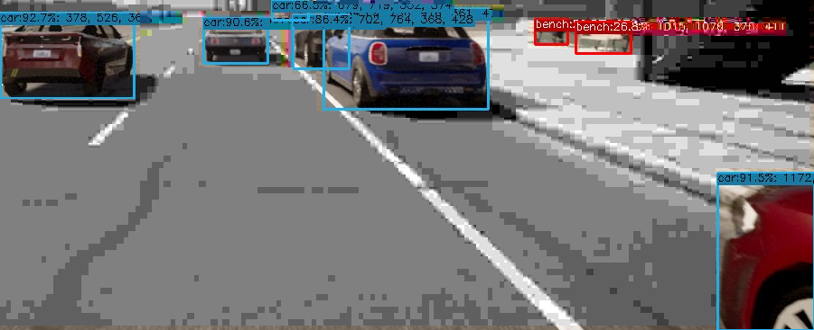
Experiment overview
Second stage 1: Data preprocessing & optimization

Slide 15
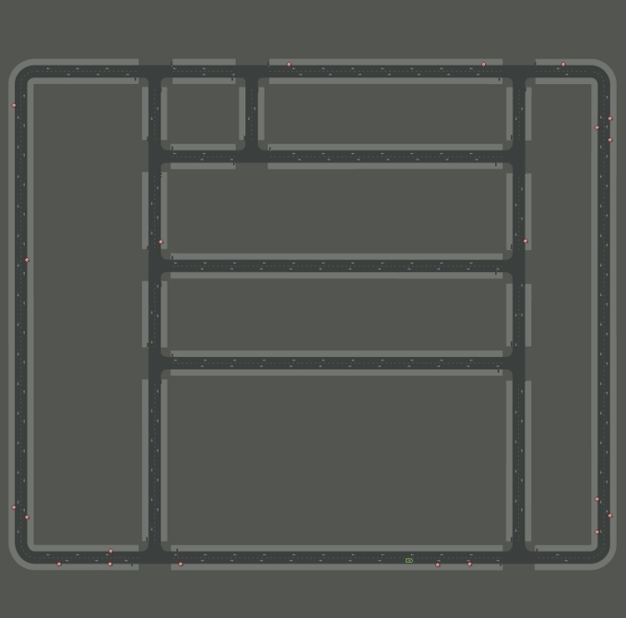


Experiment overview
Data: server locations
Goal:
To initialize server location for determining the vehicles’ relative location.
To use the server location in our observation space.
Server locations
Second stage 2.1: Data preprocessing & optimization

Slide 16
Experiment overview
Goal:
To initialize vehicle for data collection.
To use the vehicle data collected in our RL observation space.
Data: vehicle location, image size, detected objects
NOTE: The vehicle location is computed relative to the server locations.
Second stage 2.2: Data preprocessing & optimization

Slide 17
Experiment overview
Data: server locations
Data: vehicle location,
image size, detected objects
Observation space
Second stage 2.3: Data preprocessing & optimization

Slide 18
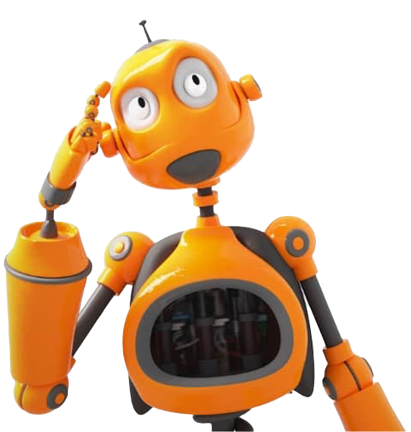
Experiment overview
Data: vehicle location,
image size, detected objects
Data: server locations
DRL Agent
Goal:
To make the DRL agent interact with our observation space.
To make decision on each vehicle and server pairs that is most optimal.
Observation space
NOTE: Consider the image size, detected objects, and distances in making decisions.
Third stage 3.1 : Vehicle selection process

Slide 19
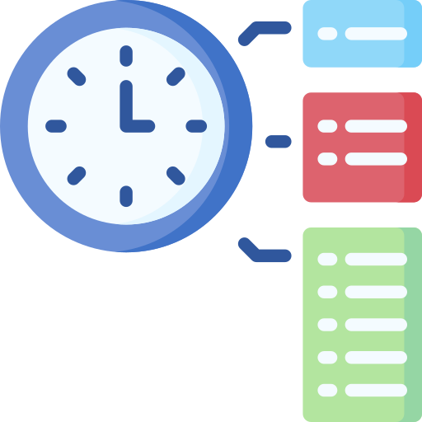
Experiment overview
Data: vehicle location,
image size, detected objects
Data: server locations
DRL Agent
Observation space
Goal:
To design the reward in terms of time taken to make a decision and storage size selected.
Reward
Third stage 3.1 : Vehicle selection process

Slide 20
Thanks!
Any questions?

